Slide 1

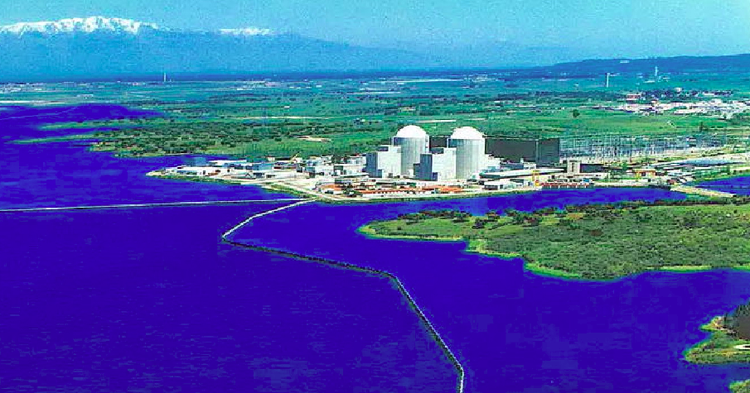
Departament de Física Atòmica, Molecular i Nuclear
TRITIUM: Design, Construction and Commissioning of an In-Water
Tritium Detector
Marcos Martínez Roig
Ph D. Dissertation
Valencia, July 2022
Supervisors
José Díaz Medina
Nadia Yahlali Haddou

